Slide 1
Python Foundations
Nichole Bennett

Slide 2
Course Information

Slide 3
About Me
Used to research climate change impacts on butterflies (ecology, evolution, behavior, some genomics)
Then, I taught adults data science with General Assembly and taught kids coding through various programs.
Now I research science communication.
In my spare time, I do improvisational acting.

Slide 4
About You
Find a partner, find out the following about them:
Name
Where they are from
What they do for work, for fun
Why they are here
One fun fact
Then, we’ll share.

Slide 5
Course Overview (subject to change)
Day 1: writing/running Python code, use Python for basic data analysis tasks (cleaning, reformatting, exploration, analysis), understand what Python is useful for
Day 2: collect data from CSVs, explore large datasets, clean and munge data to prepare for analysis, apply machine learning algorithms to gain insight from data, visualize results
Anything missing on here that you were hoping for?

Slide 6

Prerequisites
This should be pretty beginner-friendly.
Feel free to speak out if you don’t understand something--I’ll adjust.
Notes:
Domains of Machine Learning (Stats, Programming, Domain Knowledge)
Good to know where you stand here so you can know what you’d like to do to continue growing
Although many ML algorithms use linear algebra, we’ll get an intuition for what they’re doing without needing to learn it
Will provide resources for you

Slide 7

Install Help Time!
Mac/Linux Users: Go to your Terminal and type conda list
PC Users: Go to your Anaconda Prompt and type conda list

Slide 8
Questions About Course In General?
Any Requests?

Slide 9
No matter where you are now, you’ll be fine.
You have already proven that you are a self-starter and self-learner,
and that will take you far.

Slide 10
What is Python?

Slide 11

What is Python?
Created by Guido Van Rossum in 1991
Easy language to learn
Lots of contributors to modules
Emphasizes human readability

Slide 12
What is an interpreted language?

Slide 13
Python is an interpreted language
Code doesn't have to be translated into machine-language before execution (VS compiled code that is executed by the computer's CPU)
This means it's not as fast as compiled code
But also means it's more portable

Slide 14
What is an object-oriented language?

Slide 15
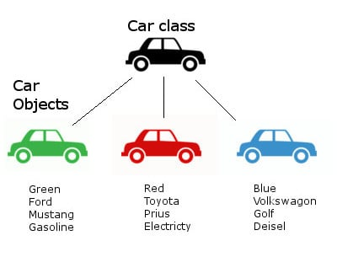
Python is an Object-Oriented language
Instead of just being a series of actions, Python lets us form "objects" that have their own data (attributes) and their own actions (methods) to modify their data.
A benefit of OO is that it is easier to reuse the code in other programs.
We'll be using lots of objects. (We may not even realize it).

Slide 16
What is a “high-level” language?

Slide 17
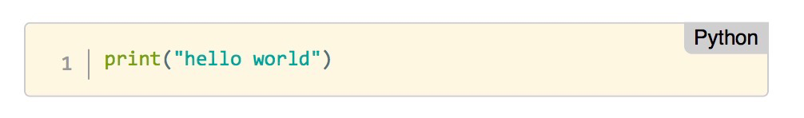
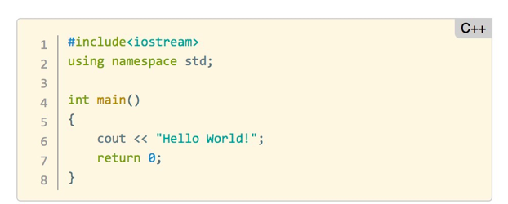
Python is a high-level language
Notes:
It uses more natural language and is easier to read

Slide 18
What is a dynamically-typed language?

Slide 19
Python is a dynamically-typed language
This means you don't have to specify what type the variables are. The computer figures it out for you

Slide 20
Why use Python?

Slide 21
Why use Python?
Quick and easy to use
Big community with lots of "batteries included" libraries (especially for machine learning)
Most libraries written by people with a computer science background, so easy to switch from library to library

Slide 22
Why not use Python?

Slide 23
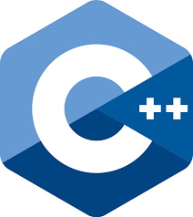

Why not use Python?
If you have something that needs speed
If you are doing lots of stats

Slide 24
Python Interactive Shells
Write code that is executed immediately by the Python interpreter.
We are able to "interact" with the results of the commands we pass. We can do this using a:
Python shell
iPython shell
Jupyter notebook

Slide 25
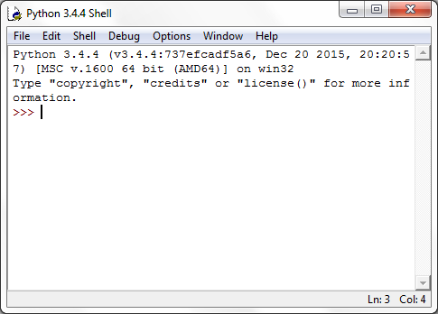
Python Shell
A python shell is similar to a Command Line Terminal and it can be launched by typing (into Terminal or Git Bash)
python

Slide 26
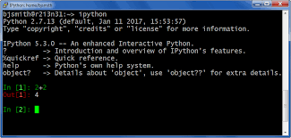
iPython Shell
iPython provides syntax coloring and shortcuts to interact with other code.
You can launch it by typing (into Terminal or Git Bash)
ipython

Slide 27
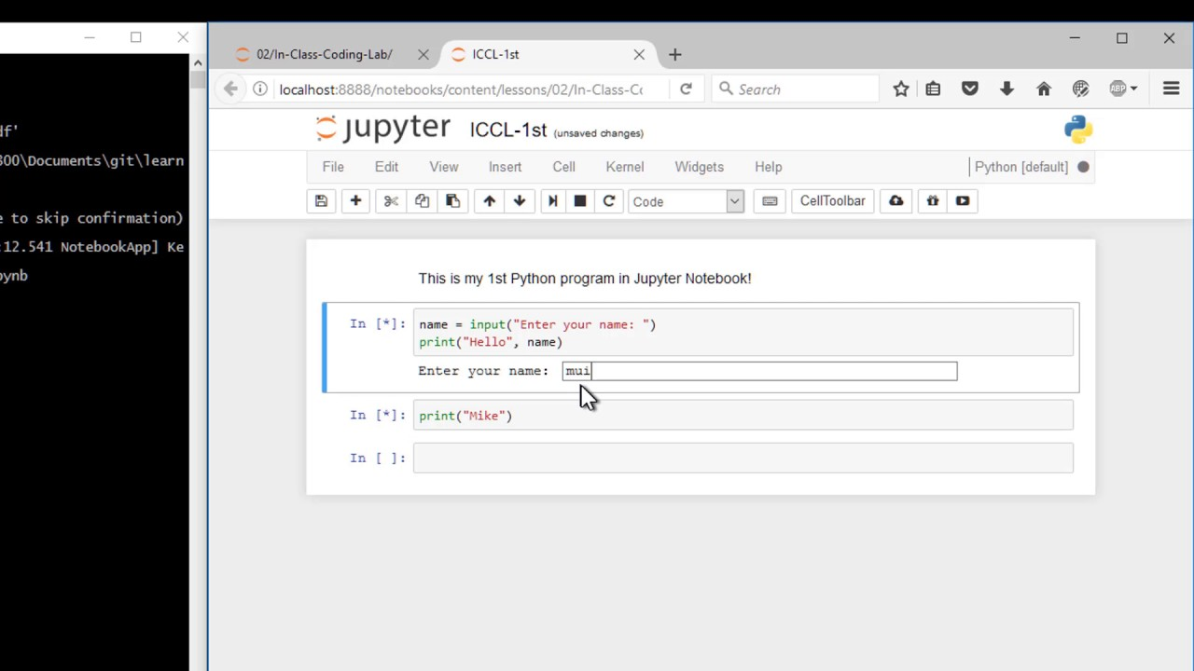
Jupyter Notebook
A Jupyter notebook is a web interface. With it we can use formatting and markdown with our code. This is what we’ll be primarily using for this course.
Mac/Linux: In the terminal type jupyter notebook
Windows: Click the "Start" button and type "cmd" type jupyter notebook
Or open Git Bash and type jupyter notebook

Slide 28
Juypter Notebooks
born out of the IPython project--grew to encompass more languages
The name Jupyter is an indirect acronym of the three core languages it was designed for: JUlia, PYThon, and R

Slide 29
Scripting
Sometimes we just want to execute a program and get results, not interact with our Python code.
In those cases, we use a Python script.
To do so, we can use a text editor of our choice and save the code in a file with extension “.py”.

Slide 30

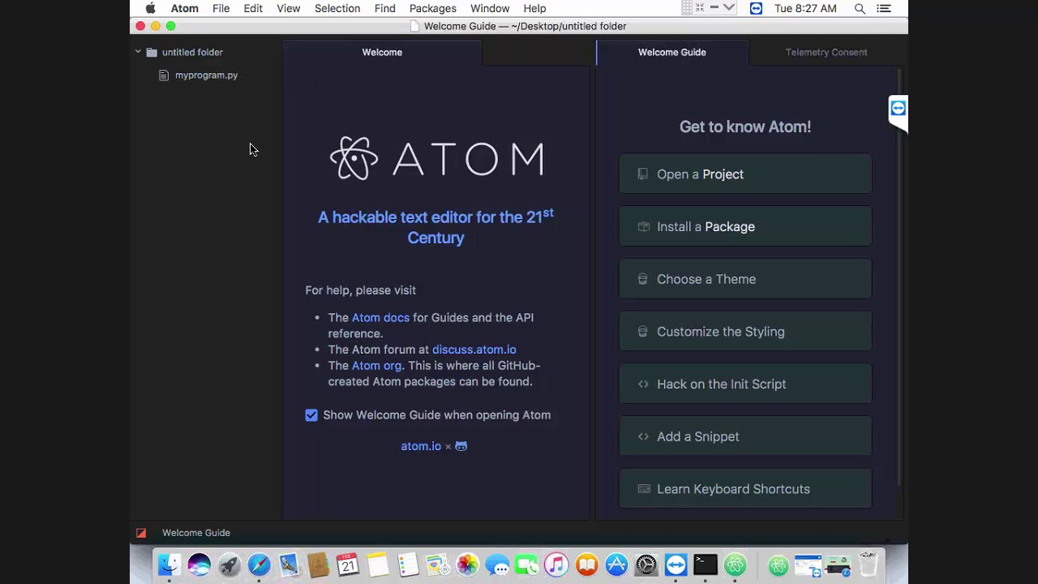
Text Editors
Some common plain text editors include:
Atom
NotePad (Win), NotePad++ (Win)
TextEdit (Mac), TextWrangler (Mac).
Nano (Linux, Mac)

Slide 31

IDEs
Integrated development environments (IDEs) provide tools for writing and testing your software (Brings tools together for you)
PyCharm
Eclipse with PyDev
Atom
Spyder (included in Anaconda)

Slide 32
Introduction to
Jupyter Notebooks
Notes:
Motivation for using Python
Motivation for using Jupyter notebooks
What Jupyter is used for (more than Python)

Slide 33

Opening a Jupyter Notebook from
Git Bash (Windows) or the Terminal (Mac)

Slide 34
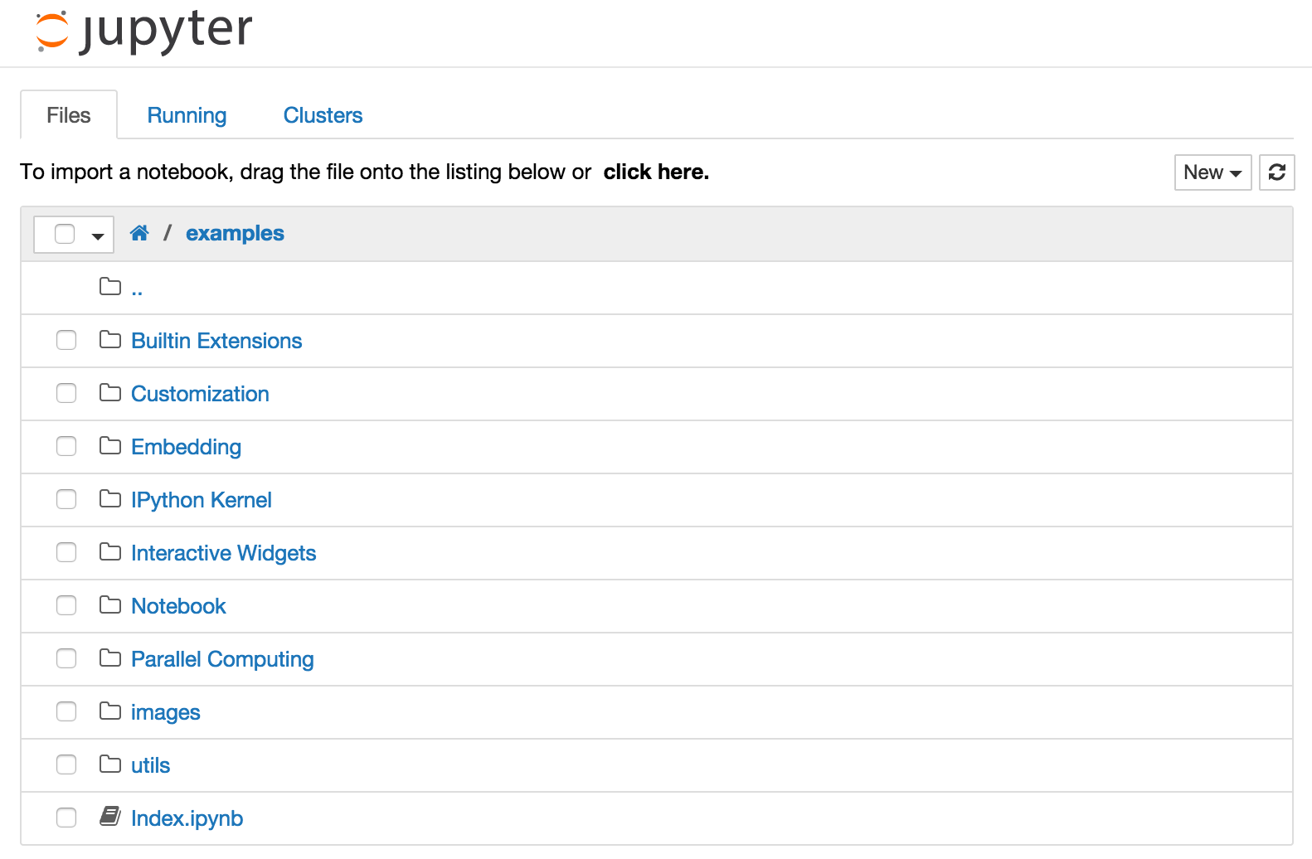
Notebook Dashboard
Notes:
This is the page you first see when you open a notebook. This will be like your “home page.” This will show whatever directory (aka folder) that you opened it in in the terminal.

Slide 35
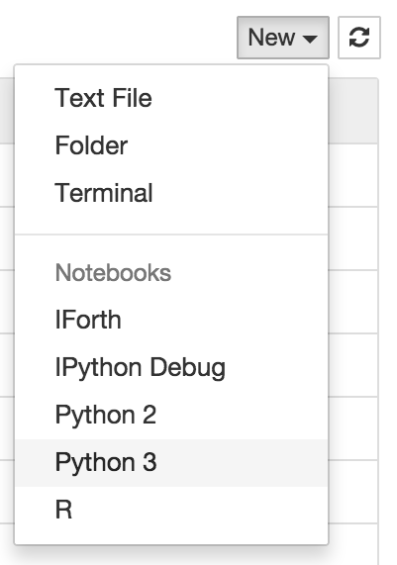
Notebook Dashboard
Notes:
To create a new notebook, click on “new” at the top of the file system. Some of these kernels (like R) may not be available to you.

Slide 36

Notebook Dashboard
Notes:
To shutdown, delete, duplicate, or rename a notebook check the checkbox next to it and an array of controls will appear at the top of the notebook list

Slide 37
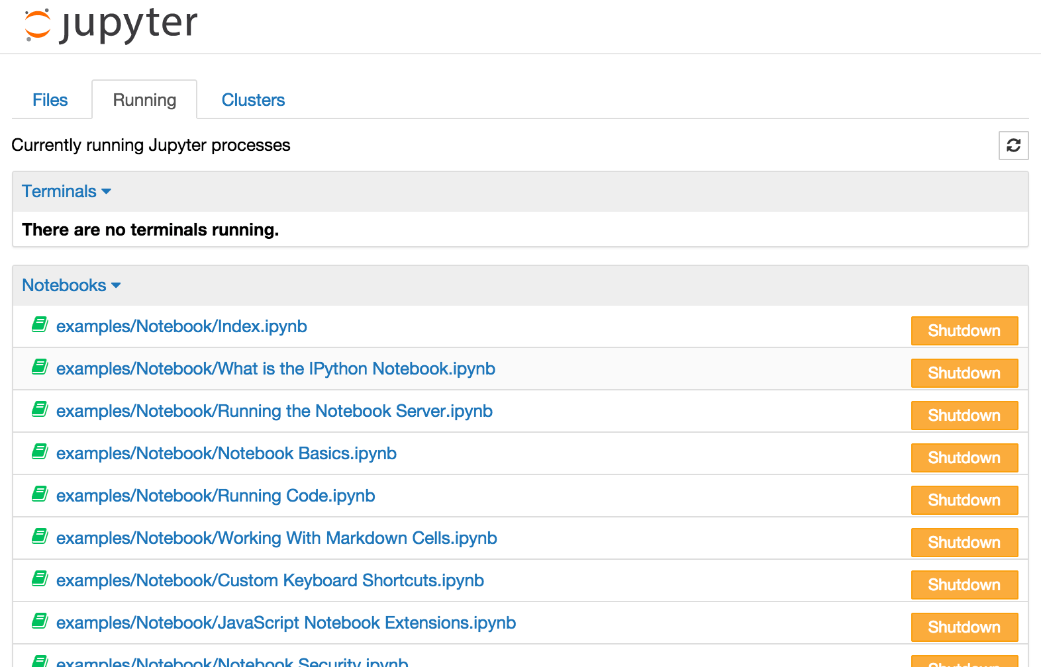
Notebook Dashboard
Notes:
To see all the notebooks that are running, you can click the “running” tab.

Slide 38
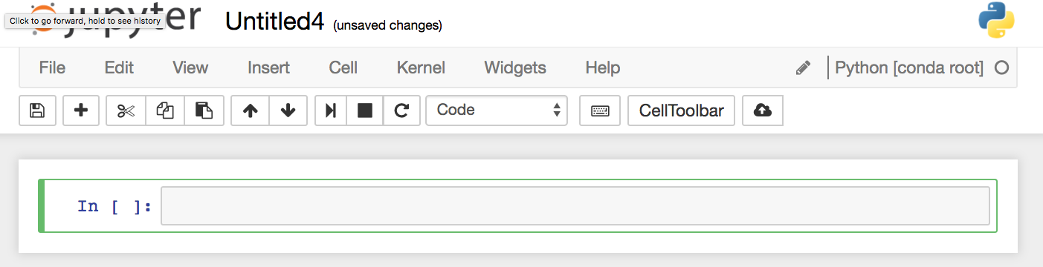
Notebook User Interface (UI)
Notes:
Create a new Jupyter notebook. This lets you create markdown and run code (talk about difference between markdown and code). The Notebook UI has three parts: Menu, Toolbar, Cells

Slide 39
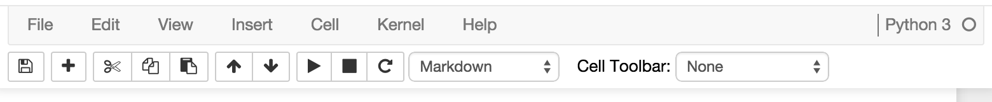
Menu and Toolbar
Notes:
Select a cell by clicking on it. It will have a border showing what mode the cell is in (blue or green). Click in the cell to enter edit mode.
You can use the run button on the toolbar to run cells. (or you can use the keyboard command shift-enter). Pretty much everything can be done with both the keyboard and the menu--use what you prefer. I like the keyboard shortcuts because I am lazy and like to feel fancy at the same time.

Slide 40
Modes
Edit Mode
Command Mode
Notes:
The keyboard does different things depending on what mode you are in. When the border is green, you can type in the cell, just like a normal text editor. When the border is blue, you can edit the notebook as a whole (doing things like adding cells above or below), but you can’t edit the cell. In Command mode, there are tons of useful shortcuts you can use. For example if you press “c” it will copy the cell.

Slide 41
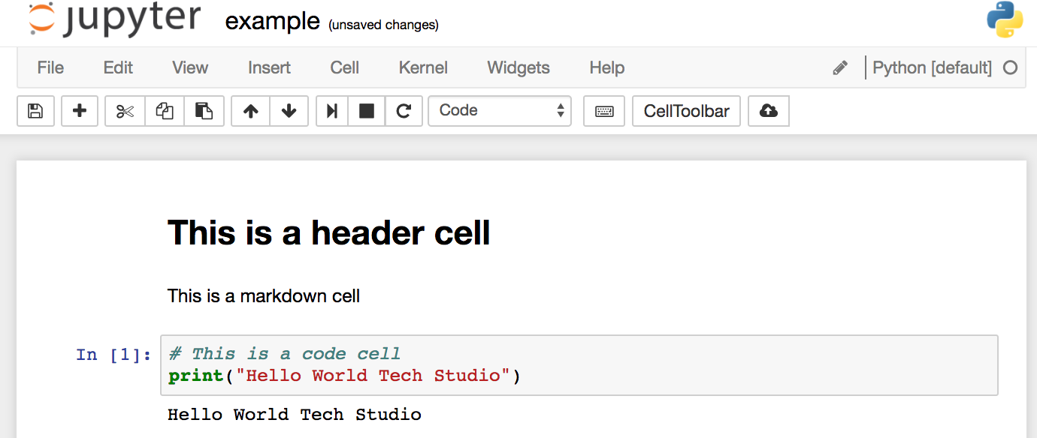
Headers, and markdown, and code (oh my!)

Slide 42
Keyboard shortcuts
Go to Help > Keyboard Shortcuts (or Cmd + Shift + P/Ctrl + Shift + P)
Some useful ones:
Esc will take you into command mode where you can navigate around your notebook with arrow keys….While in command mode:
A to insert a new cell above the current cell, B to insert a new cell below.
M to change the current cell to Markdown, Y to change it back to code
D + D (press the key twice) to delete the current cell
Enter will take you from command mode back into edit mode for the cell.

Slide 43
Keyboard shortcuts
Go to Help > Keyboard Shortcuts (or Cmd + Shift + P/Ctrl + Shift + P)
Some useful ones:
Shift + Tab will show you the Docstring (documentation) for the the object you have just typed in a code cell
keep pressing this short cut to cycle through a few modes of documentation.
Ctrl + Shift + - will split the current cell into two from where your cursor is.
Esc + F Find and replace on your code but not the outputs.

Slide 44
Keyboard Shortcuts
Go to Help > Keyboard Shortcuts (or Cmd + Shift + P/Ctrl + Shift + P)
Some useful ones:
Select Multiple Cells:
Shift + J or Shift + Down selects the next sell in a downwards direction. You can also select sells in an upwards direction by using Shift + K or Shift + Up.
Once cells are selected, you can then delete / copy / cut / paste / run them as a batch. This is helpful when you need to move parts of a notebook.
You can also use Shift + M to merge multiple cells.

Slide 45
Jupyter Notebook Demo
Notes:
Get to Jupyter
Add a code cell
Add a text cell
Delete a cell
Run a code cell (show print)
Repeat x2
Make a note of the file endings for jupyter notebooks

Slide 46
Jupyter Notebook Obstacle Course
Open a new notebook
Name the file something specific and useful
Add a header for your name
Add a code cell
Print a short sentence about yourself
Add some markdown
Explore!
Notes:
Open a new notebook
Name the file something specific
Add a header for their name
Add a code cell
Print a short bio

Slide 47
CTRL + C to close out of the Jupyter Notebook from the Terminal or Git Bash

Slide 48
Getting Help
Help menu has documentation for some common libraries
Place ? before a library, method, or variable for a quick syntax reference
You can execute shell commands in notebooks by prepending the command with !

Slide 49
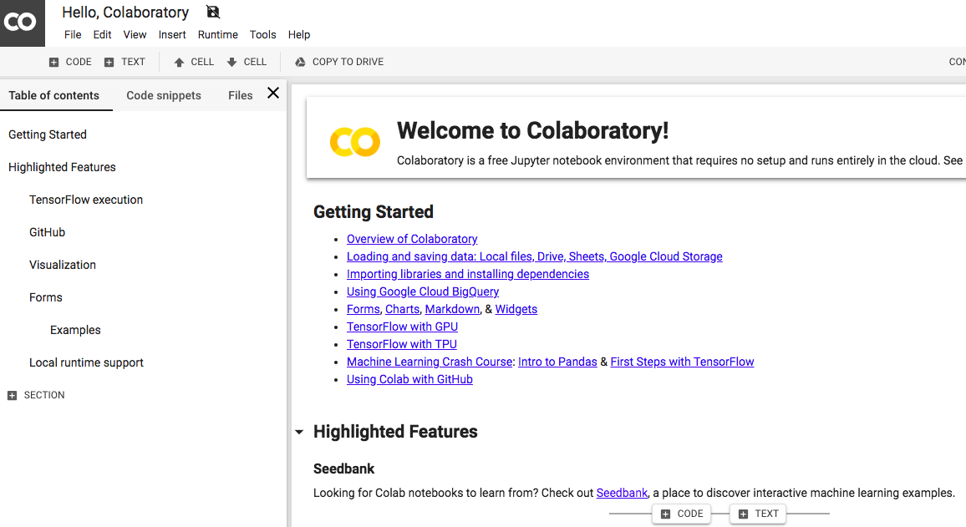

Slide 50
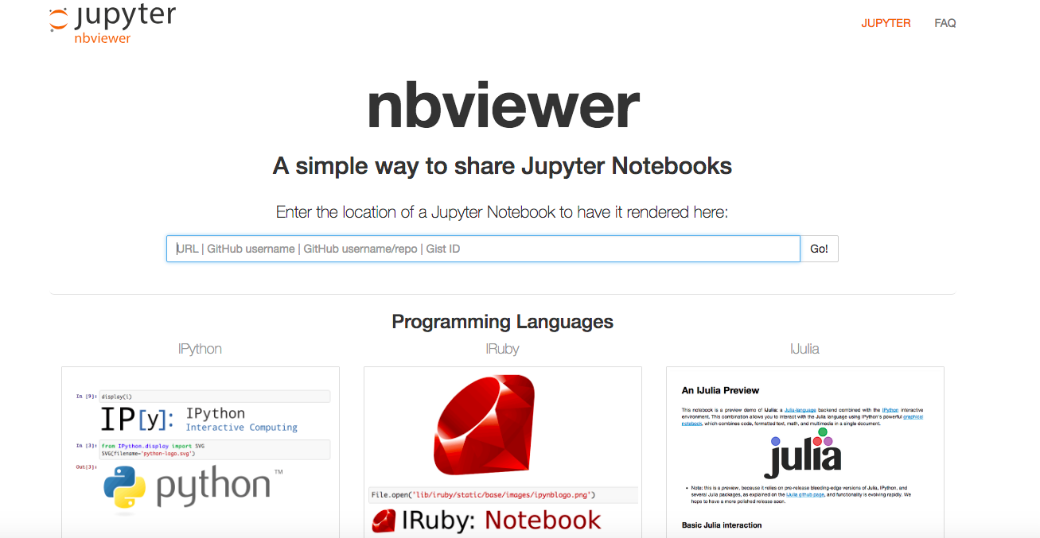

Slide 51
Self-Diagnosis: Comfort With Python
Line up according to how well you think you’d be able to teach Python basics to someone else (e.g. functions, for loops, if/else, lists, dictionaries…)
Then:
Mob Coding (5 groups of 3) on Part 1 and 2
1 driver, 1 navigator, 1 thinker
Goal is to get every member of the group to understand
Then:
Do Python Foundations Practice on your own.

